Slide 1
Docker Compose
Sameer Zulfi

Slide 2
How to deploy multi-container applications
Earlier we used One Single Dockerfile which will run One Single Application in One Single Container.
If you want to run multi container applications, how ??? We should use Docker Compose.

Slide 3
Little bit history of Compose
It was Originally called by “Fig” and the company it was owning was Orchard.
Fig was written in Python and the best way to manage multi-container.
Fig uses Yaml File to run the multi-container apps
Docker liked this idea and acquired Orchard Company.
They have renamed the Fig to “Docker-Compose”
You have to separately install Docker-compose. It will not be come with the docker engine package.

Slide 4
Installing Compose
Two Step Process
1. Download the Binaries
2. Make it executable
sudo curl -L "https://github.com/docker/compose/releases/download/1.24.1/docker-compose-$(uname -s)-$(uname -m)" -o /usr/local/bin/docker-compose
sudo chmod +x /usr/local/bin/docker-compose
Now check the version.
docker-compose --version

Slide 5
Yaml Files
It is a subset of json
The naming should be by default “docker-compose.yml” or “docker-compose.yaml”
We are going to take one Python Flask Application as example.
The yaml file has two services.
1. web-fe and 2. redis
It is a Simple Web Server that counts the no., of visits and stores the values in redis database

Slide 6
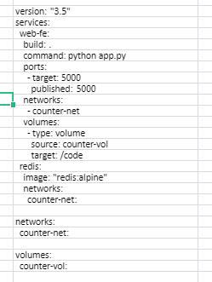
Our Compose file
It has 4 main sections.
1. version
2. services . Under services we have two sub services
3. networks
4. volumes

Slide 7
Let’s execute
Clone this git repo using “git clone https://github.com/nigelpoulton/counter-app.git”
Please open the Dockerfile, app.py & docker-compose file. Analyze it.
Let’s run this
docker-compose up –d ( will run in the background )
Docker ps
Docker network ls
Docker volume ls
Hurray.. Your Multi-Container App is running.. But.. Let’s go to next slide.

Slide 8
Exploring more..
Docker-compose top
Docker-compose stop
Now try docker ps… what do you see.. Why ??
Docker-compose restart
Now Verify by this command “docker-compose ps”
Build indicates a path containing a Dockerfile
COMMAND indicated what to run ( like CMD in Dockerfile )
docker-compose kill
Docker-compose rm
Docker-compose down
Docker-compose down –v (including volumes)

Slide 9
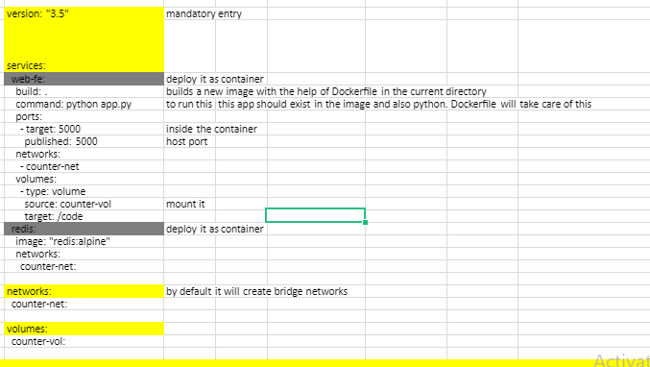
Let’s operate

